Slide 1


Participating RAP Programs
Recreation & Parks Program
(RAP)

Slide 2

Participating RAP Programs
The Food Services Division entered a service contract with the City of Los Angeles Recreation and Parks Department (RAP).
Participating RAP Programs
  96 Parks and Recreation Centers
The Food Service Division assumes full responsibility for meeting all food safety and meal requirements for payment of services rendered.

Slide 3
RAP Program
Program Dates
  6/12/25 – 8/1/25
  Staff your sites to support the RAP program until 8/1/25
Menus
  FSD central office provides a menu to RAP prior to the program
Preparation and packaging of meals
  Meals will be packed in insulated BIC bags
  Milk and juice or fruit will be packed together as cold items
  Keep hot food hot and cold food cold
  Condiments will be included with each individual meal
  White and Chocolate Milk

Slide 4
FSD Staff Role
The Food Services Manager will:
  Place orders for all products needed in CMS
  Receive and store deliveries, complete all receiving tickets
  Prepare, package and deliver meals to RAP and/or other locations assigned
  Ensure FS driver carries a copy of their ServSafe Certificate and/or the LAUSD Food Handler’s Certificate when transporting food
  Complete Summer Daily Meal Transport Record for each program
  Retrieve the insulated bags, heating and cooling elements daily
  Ensure bags are cleaned for use daily

Slide 5
FSD Staff Role
  List the RAP program and amount of meals transported on the production worksheet under the “Comments Section”
  Input counts in the RAP Weekly Report Form 3 survey
  Be responsible for the quality, safety and oversight of the meals
  Complete all HACCP records
    Includes taking temperatures of all meals prepared and milk
  Record the temperatures on the “Summer Daily Meal Transport Record” form
  Ensure mileage is properly tracked, recorded and claimed

Slide 6
HACCP Requirements
Food preparation, storage and meal delivery must follow all HACCP/Food Safety procedures:
  Employees wear appropriate safety attire and Personal Protective Equipment (PPE)
  Sanitation and Personal Hygiene requirements
HACCP forms posted and completed daily
  Thermometer Calibration Logs
  Food Temperature Logs
  Summer Daily Meal Transport Record
    Accurate and timely temperatures are taken and recorded
  Equipment Temperature Logs
    Equipment malfunctions are reported for repairs

Slide 7
Participating RAP Programs
Menu

Slide 8
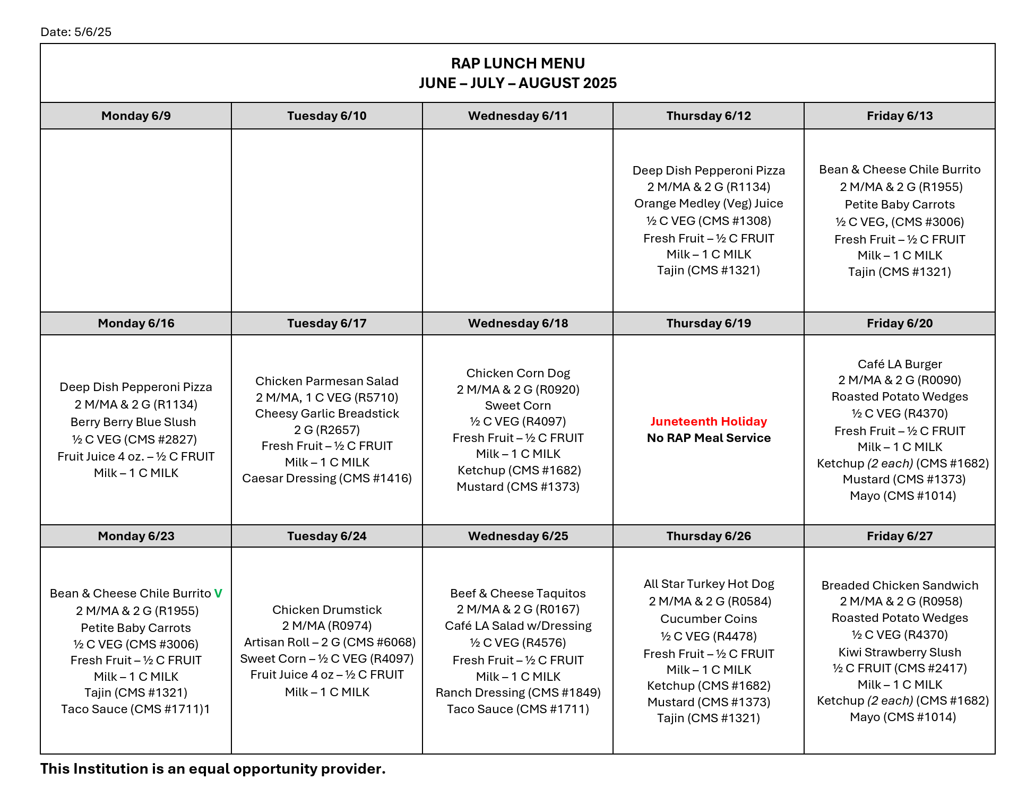
RAP Summer Menu

Slide 9
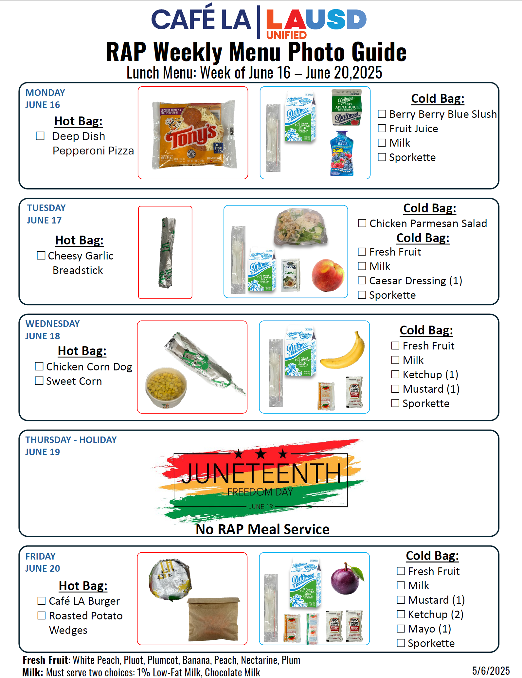
Weekly Lunch Menu Guides
Food Service staff will prepare and package meals according to the Weekly Lunch Menu Guides
  Lunch menu guides are available on the FSD website
    8 weeks of the RAP program
  Guides are used as a reference for packaging required
    Bagged meal contents
      Cold bagged meals
      Hot bagged meals

Slide 10
Milk Variety
Food Service staff will provide both white and chocolate milk to RAP.
  Review the RAP Daily Food Order to determine the amount of meals needed.
  Twenty percent (20%) of the milk provided will consist of white milk.
  Eighty percent (80%) of the milk provided will consist of chocolate milk.
  Place the cold bag(s) containing the white milk inside insulated bag, where it can be easily seen.

Slide 11
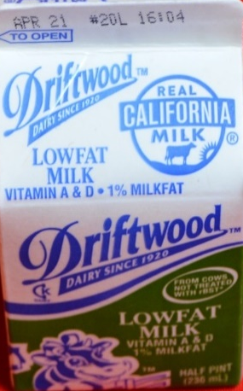
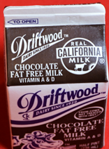
Calculating Milk Quantities
To determine the percentage of white milk needed, multiply the number of meals by 20%.
Example - 30 meals are ordered
  30 meals x 20% = 6
  Round the number up to the next whole number if needed
Provide 6 white milk
Provide 24 chocolate milks

Slide 12
Calculating Milk Quantities
To determine the percentage of white milk needed, multiply the number of meals by 20%.
Example - 55 meals are ordered
  55 meals x 20% = 11
  Round the number up to the next whole number if needed
Provide 11 white milk
Provide 44 chocolate milks

Slide 13
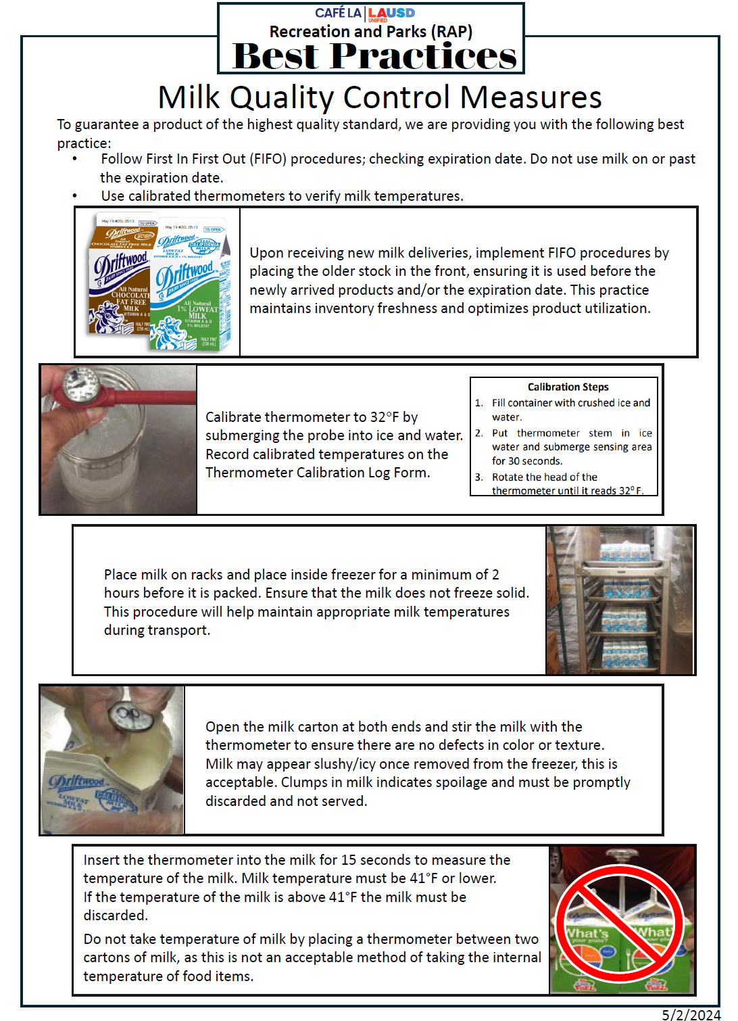
Milk Quality Control Measures
To provide milk to sites at an acceptable cold temperature of below 41°F, Food Service staff will:
  Place milk flats needed for the program inside the freezer for 2 hours
  Milk consistency will be slushy
  Remove milk flats from the freezer
  Package cold bagged meals in small batches to retain the cold food temperature
  Provide 1 extra milk for on site quality control testing

Slide 14
Participating RAP Programs
Best Practices

Slide 15
Best Practices
Use the Best Practices as guides to assist with all RAP procedures.
  Weekly Lunch Menu Guides
  Milk Quality Control
  Hot Packaged Meals
  Cold Packaged Meals
  Insulated Bag Packaging Guide
  Cooling Elements
  Heating Elements
  CMS Packaging Order Guide
  Quality Control Check

Slide 16
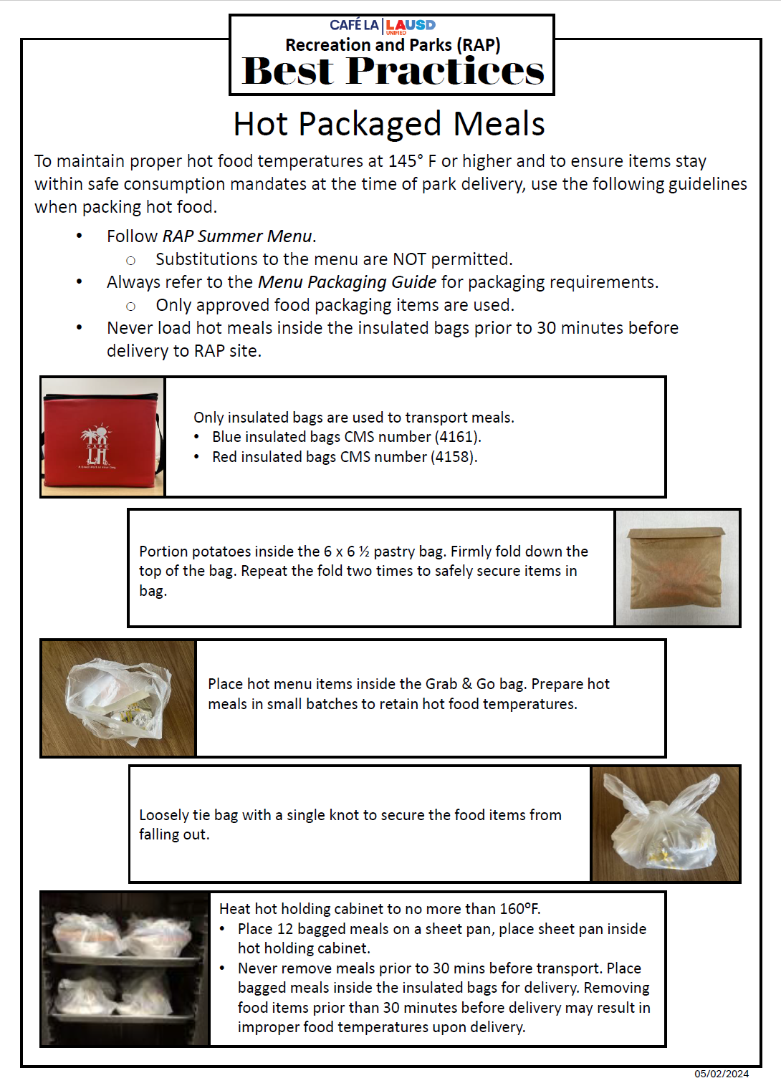
Hot Packaged Meals

Slide 17
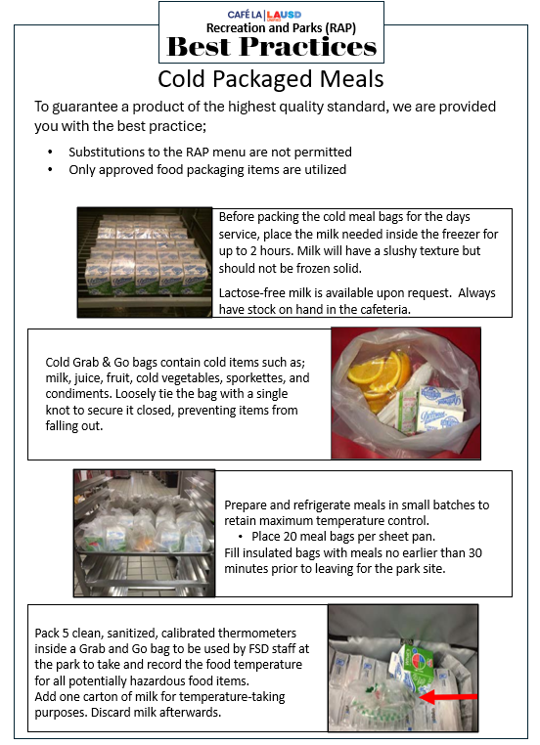
Cold Packaged Meals

Slide 18
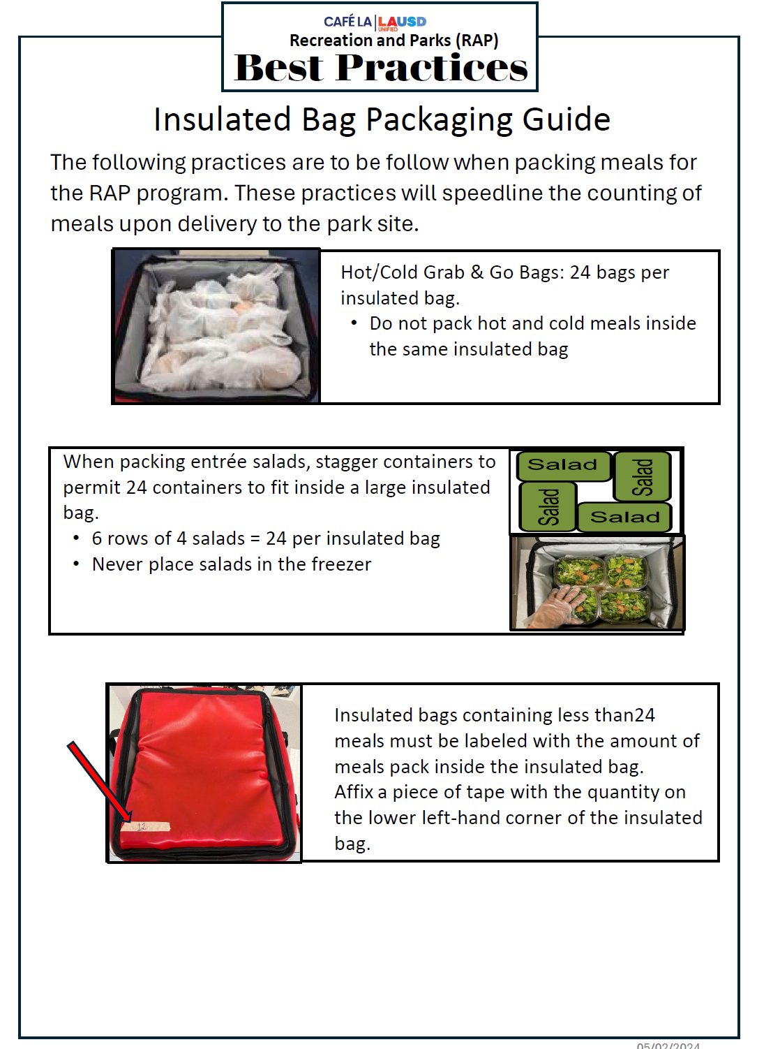
Insulated Bag Packaging Guide

Slide 19
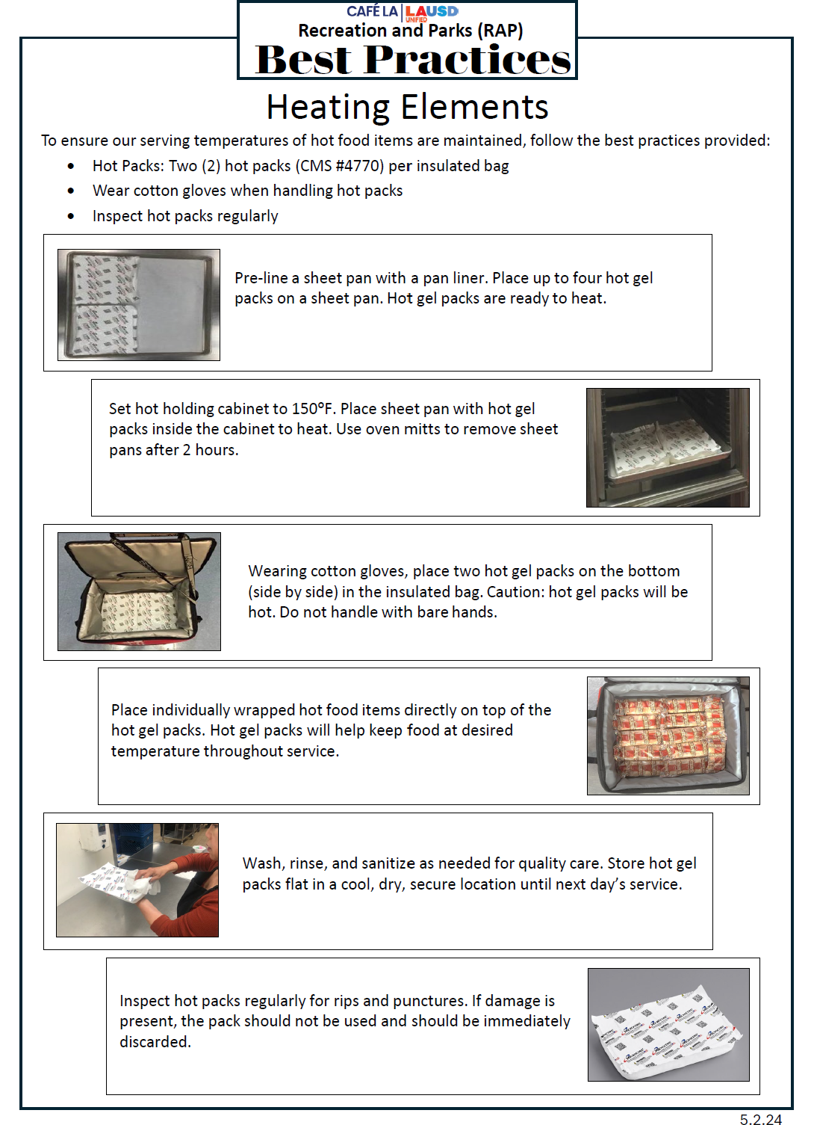
Heating Elements

Slide 20
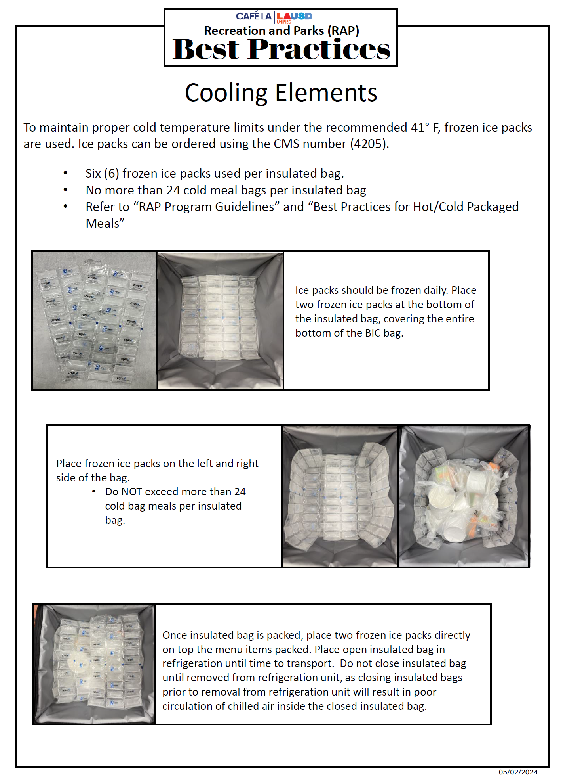
Cooling Elements

Slide 21
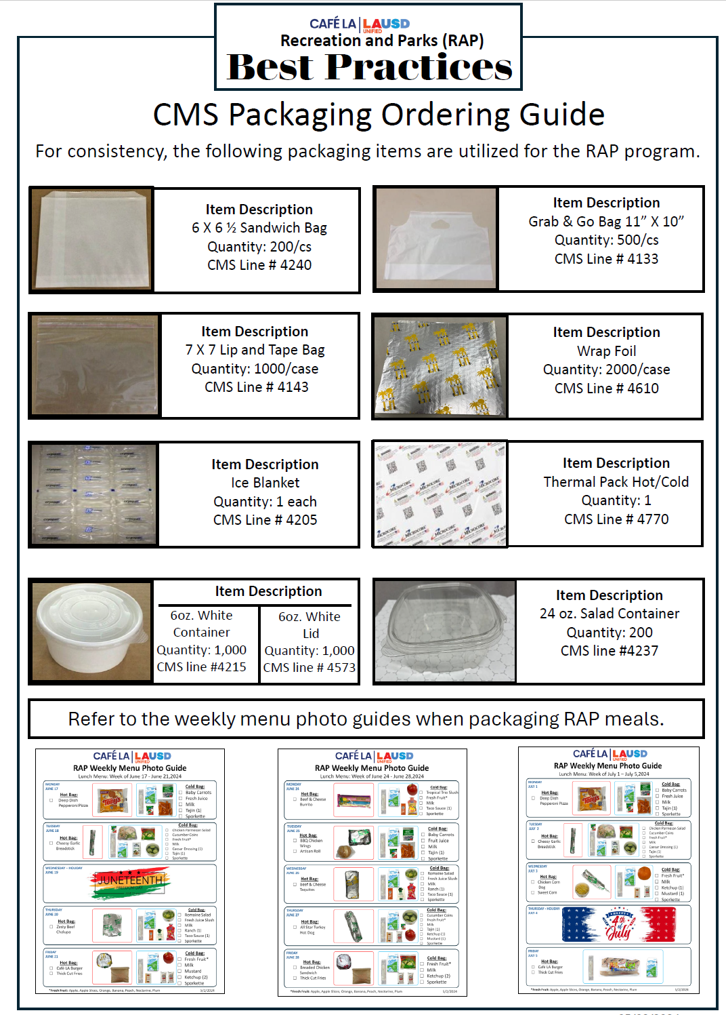
CMS Packaging Order Guide

Slide 22
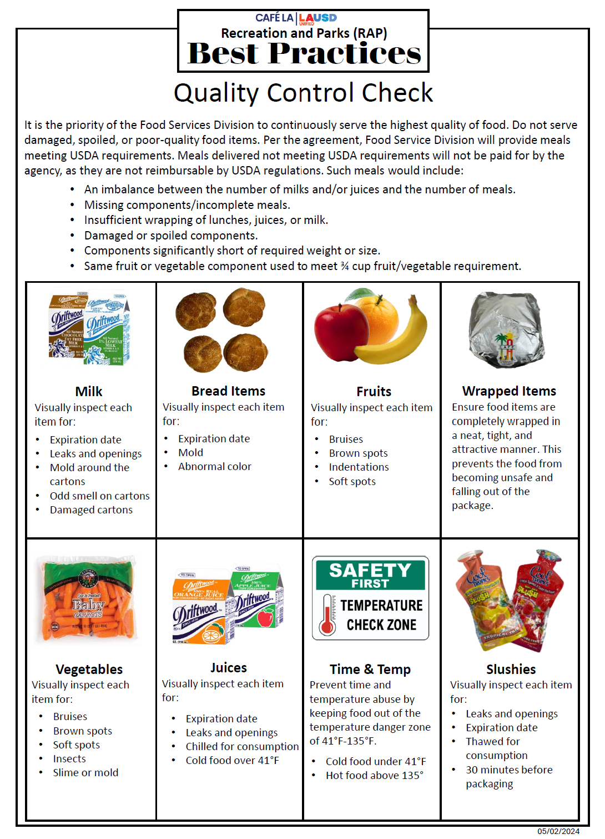
Quality Control Check

Slide 23
Participating RAP Programs
Unacceptable Meals

Slide 24
Unacceptable Meals
Meals delivered not meeting USDA requirements will not be paid for by the Department of Recreation and Parks, as they are not reimbursable by USDA regulations.
This includes:
  Meals not delivered
  An imbalance between the number of milks and/or juice and the number of meals
  Incomplete meals (missing menu items)
  Components short of required weight or size
  Meals delivered late of the serving time

Slide 25
Quality Control Hazards
It is important to inspect all food items that are being packed and delivered to RAP for quality control. Failure to do so, will result in the program claiming unacceptable meals which can lead to financial loss.
Quality control factors considered unacceptable:
  Insufficient wrapping of food items
  Damaged or smashed food items
  Spoiled components (e.g. frozen, soggy, moldy)
  Leaking items in packaged meals
  Foul smelling items (e.g. milk, juice packages)

Slide 26
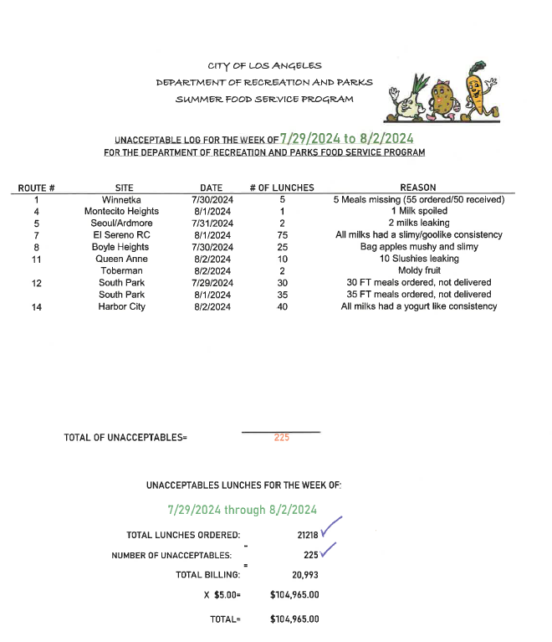
RAP Unacceptable Log
Every week, FSD receives an Unacceptable Log from the Department of Recreation and Parks.
This reports the number of meals that the program has deemed unacceptable and the reason for no payment of services.

Slide 27
Financial Loss
Week of 7/29/24-8/2/24
225 meals x $5.00 = $1,125.00 financial loss for FSD

Slide 28
Prevent Time and Temp Abuse
To continue to serve the highest quality of food, it is important to prevent time and temperature abuse when transporting food items to RAP.
  Pack and transport 5 thermometers in a food grade bag
    One thermometer per each menu item
  Record the temperature of each potentially hazardous food item (e.g. entrée, vegetable, milk)
  Record the time the temperature of each item was taken
    All temperatures must be taken in front of a RAP program staff member and recorded on the Summer Daily Meal Transport Record

Slide 29
Participating RAP Programs
Meal Orders

Slide 30
RAP Daily Meal Order
RAP will provide the Daily Food Order to the FSD central office
  Lisa Hess will post the RAP Daily Food Order for each RAP site on the FSD web site under- Summer 2025
  FSM will review the Daily Meal Order to obtain the lunch count for the day
  FSD will not accept direct lunch orders from the RAP site

Slide 31


RAP Daily Meal Order

Slide 32



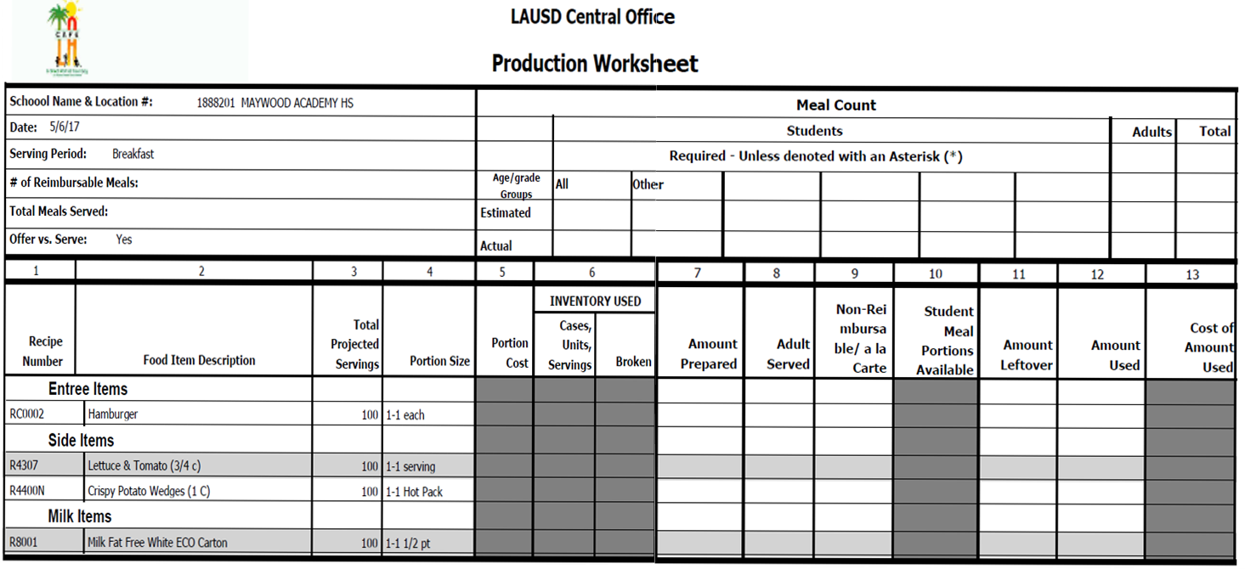

Computer Issues
In the event you are unable to log in the to Café LA website to obtain meal counts for your RAP Program:
  Contact another cafeteria to get assistance from the manager
  If another manager is unable to assist, contact AFSS
  If meal counts are not posted on the Café LA website by 7:30 a.m., contact Dawn Soto at dawn.soto@lausd.net or 213-923-9603.

Slide 33
Participating RAP Programs
Delivery & Required Documentation

Slide 34
Delivery of Meals
  Follow the specific delivery time as stated on the RAP program list available on the Café LA website.
  FSD is required to deliver meals 30 minutes prior to the start of the meal service.
  Drivers will complete the Summer Daily Meal Transport Record form – prepare three copies
      2 to RAP
      1 returned to the cafeteria
Notes:
TELL: Drivers will deliver meals according to the delivery schedule. RAP programs have specific lunch service times and we are required to deliver the meals 30 minutes prior to the start of their meal service. Follow the specific delivery time as stared on the RAP program list that is available on the FSD websites Summer 2020 page. Drivers will complete three copies of the Summer Daily Meal Transport Record form 2 will be given to the RAP Program. We will discuss in detail during the upcoming slides on how to complete this document. As with most summer programs, children attend fun, engaging field trips. The RAP main office must provide field trip requests 2 days in advance. RAP parks and recreation centers are not permitted to request filed trip meals directly thought the Food Service Manager or Driver. Approved field trip meals will be listed on the daily meal order and the field trip lunches will be delivered to the RAP site one day prior to the planned field trip. The reason we provide the field trips lunches one day prior is because the busses leave the RAP sites at 8am in the morning and the Food Service Division only provides one meal delivery per day. RAP sites will store the shelf stable meals in a secure location and will refrigerate the milk overnight. We will not leave ice packets or insulated bags at the sites overnight for their field trip usage.

Slide 35
Required Documentation
The following documents must be completed daily and always retained on hand:
  Production Worksheet and Production Records
    Indicate the number of meals transferred to RAP in the Comments Section
  Summer Daily Meal Transport Record
  HACCP Logs
    Thermometer calibration
    Refrigerator and freezer temperature
    Food temperature
    Equipment temperature
  RAP Weekly Report Form 3 Survey
Notes:
TELL: The following documents must be completed daily and retained on hand at all times. The production worksheet and production records. Indicate the number of meals transferred to RAP in the Comments Section on the production worksheet. The Summer Daily Meal Transport Record, Food Temperature Logs, and the RAP Weekly Report Form 3 Survey.

Slide 36
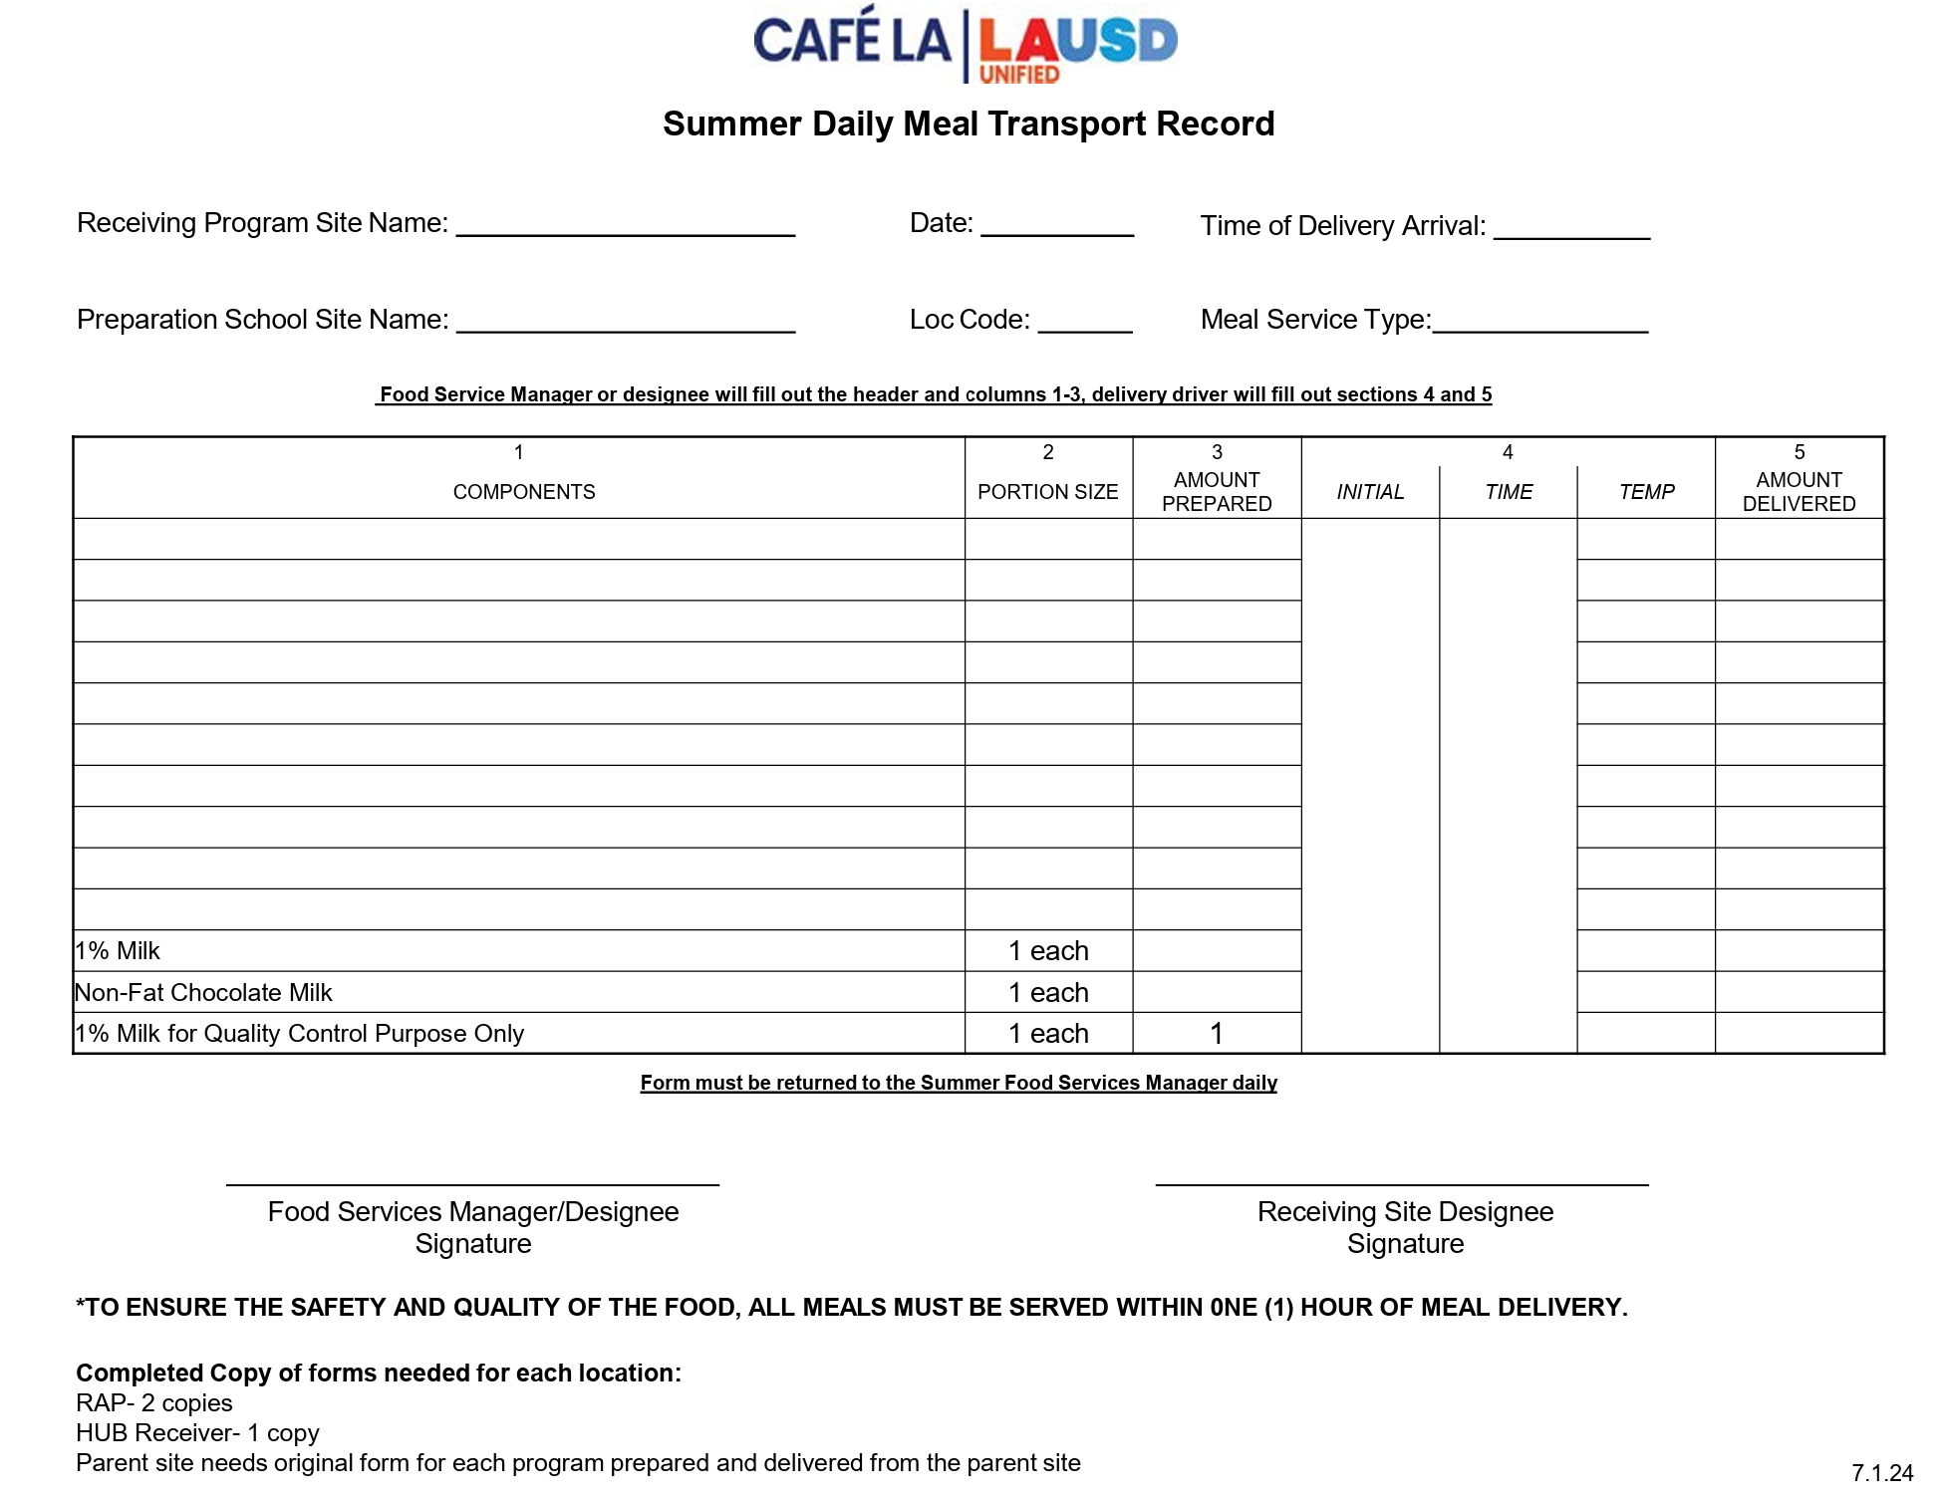
Summer Daily Meal Transport Record
The “Summer Daily Meal Transport Record ” form must be completed daily for all food transported for each program site and meal service type.
Meal Service Type
  Lunch
Notes:
TELL: The Summer Daily Meal Transport Records must be completed daily for all food transported for each meal service type; such as lunch or field trip for all off site programs. You will provide each RAP location with 2 copies of the form to keep in a folder at the site for the program. The HUB site will keep original form for each program.

Slide 37
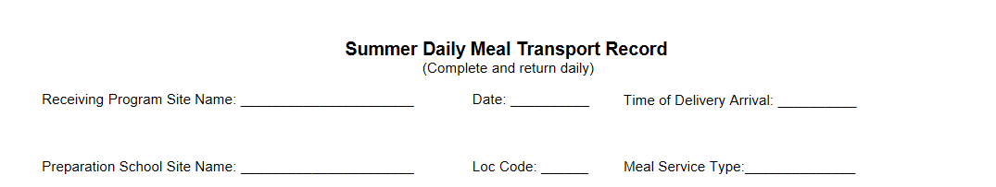
Summer Daily Meal Transport Record: Heading
The Food Services Manager or designee will complete the form.
Heading Information
  Receiving Program Site Name, Date, Time of Delivery Arrival, Preparation School Site Name, Prep Site Location Code, and the Meal Service Type
Notes:
TELL: The Summer Daily Meal Transport Record Form instructions are readily available on the back of the form for quick reference. It is important to complete all sections of the Summer Daily Meal Transport Record Form as required.
The Food Service Manager or designee must fill in the heading information. The heading includes the receiving program site name, date of meal service, complete name of the preparation school site, prep site location code and the meal service type.

Slide 38
Summer Daily Meal Transport Record: Column 1-3
Prior to delivery, the Food Services staff will complete:
  Column 1 - Components
  Column 2 - Portion Size
  Column 3 - Amount Prepared
Notes:
TELL: Prior to delivery, the Food Services staff will complete
column 1 through 3. Column 1 lists the all the menu items prepared ex. turkey breast sandwich on one line and baby carrots on another as indicated on the menu. Column 2 contains the portion sizes of the menu items listed and Column 3 includes the amount of meals prepared.
.

Slide 39
Summer Daily Meal Transport Record: Columns 4-6
Food Services staff will complete:
  Column 4 - Initial, Time, and Temperatures
    Take temperatures in presence of a RAP representative
  Column 5 - Amount Delivered
Notes:
TELL: Upon delivery, the Food Services staff will complete Columns 4 and 5. Column 4 will be filled out at the receiving site at time of drop off, including the temperature of the potentially hazardous menu items, the time the temperatures were taken and the initials of the person recording the information.
Column 5 will be filled out by Food Services Driver with the amount of the food items delivered to the program.

Slide 40
Summer Daily Meal Transport Record: Verification Signatures
A signature from the designated receiver must be obtained to verify receipt of the meals.
The Food Services Manager will verify that all information is complete and sign in the designated area.
Notes:
TELL: A signature from the designated receiver must be obtained to verify receipt of the meals. The Food Services Manager will verify that all information is complete and sign in the designated area.
The RAP centers is the only program you leave two completed copies for.
The HUB site will need the original form for each program for filling.
Note: Instructions for completing the form are listed on the back of the form along with how many copies will be provided to each program.

Slide 41
Record Requirements Recap
For every RAP delivery:
  Prepare and take three (3) copies of the Summer Daily Meal Transport Record
  Take temperatures of the milk and potentially hazardous food items immediately upon delivery
    Temperatures must be taken in the presence of the RAP representative
    Record the actual food temperatures
    Record the exact time the temperatures were taken
  Obtain the RAP representatives signature upon delivery
  Leave two copies with the RAP representative, return the third copy to the cafeteria for filing
NOTE: RAP programs do not use the “Daily Meal Count Form” and it should not be provided.
Notes:
TELL: As mentioned earlier, prepare and take three (3) copies of the Summer SFSP Daily Meal Transport Record with every RAP deliver and complete daily for all food transported. Take temperatures of the milk and food items immediately upon delivery in the presence of the RAP representative. Record the actual food temperatures and the exact time the temperatures were taken.

Slide 42
Participating RAP Programs
Field Trips

Slide 43
Field Trips
Field trip meals will be delivered on the day they are ordered on the Daily Meal Order Form.
    Only approved field trip meals will be listed on the Daily Meal Order
    Park staff may not place verbal field trip orders with the drivers or Food Service Manager
      RAP central office will refuse to pay for verbal field trip meal accommodations
Notes:
TELL: Drivers will deliver meals according to the delivery schedule. RAP programs have specific lunch service times and we are required to deliver the meals 30 minutes prior to the start of their meal service. Follow the specific delivery time as stared on the RAP program list that is available on the FSD websites Summer 2020 page. Drivers will complete three copies of the Summer Daily Meal Transport Record form 2 will be given to the RAP Program. We will discuss in detail during the upcoming slides on how to complete this document. As with most summer programs, children attend fun, engaging field trips. The RAP main office must provide field trip requests 2 days in advance. RAP parks and recreation centers are not permitted to request filed trip meals directly thought the Food Service Manager or Driver. Approved field trip meals will be listed on the daily meal order and the field trip lunches will be delivered to the RAP site one day prior to the planned field trip. The reason we provide the field trips lunches one day prior is because the busses leave the RAP sites at 8am in the morning and the Food Service Division only provides one meal delivery per day. RAP sites will store the shelf stable meals in a secure location and will refrigerate the milk overnight. We will not leave ice packets or insulated bags at the sites overnight for their field trip usage.

Slide 44
Field Trip Meals
Have field trip meal kits available on hand (2-days worth) for the start of the program. Continue to order to accommodate field trip requests for the duration of the summer.
  Beef Stick Meal Kit (CMS#1688)
  Milk
  *Order with your Summer Orders
  Use the original box for field trip deliveries; include milk when delivering field trip meals.
  Insulated bags, hot packs, and ice blankets are NOT used for RAP field trip meals.
Notes:
TELL: Drivers will deliver meals according to the delivery schedule. RAP programs have specific lunch service times and we are required to deliver the meals 30 minutes prior to the start of their meal service. Follow the specific delivery time as stared on the RAP program list that is available on the FSD websites Summer 2020 page. Drivers will complete three copies of the Summer Daily Meal Transport Record form 2 will be given to the RAP Program. We will discuss in detail during the upcoming slides on how to complete this document. As with most summer programs, children attend fun, engaging field trips. The RAP main office must provide field trip requests 2 days in advance. RAP parks and recreation centers are not permitted to request filed trip meals directly thought the Food Service Manager or Driver. Approved field trip meals will be listed on the daily meal order and the field trip lunches will be delivered to the RAP site one day prior to the planned field trip. The reason we provide the field trips lunches one day prior is because the busses leave the RAP sites at 8am in the morning and the Food Service Division only provides one meal delivery per day. RAP sites will store the shelf stable meals in a secure location and will refrigerate the milk overnight. We will not leave ice packets or insulated bags at the sites overnight for their field trip usage.

Slide 45
RAP Daily Meal Order: Field Trips
Field trip meals will be delivered on the day they are ordered on the Daily Meal Order Form.

Slide 46
Participating RAP Programs
Billing of Services

Slide 47
Billing of Services
The RAP meals are reported in the Weekly Report Form 3 survey.
The link to the Survey is posted on the FSD website - Summer 2025 tab.
  The RAP Weekly Report Form 3 will be posted on Thursday afternoons for the current week.
  Sites with more than one RAP Program will need to complete a separate survey for each RAP site.
  The survey must be completed and submitted each Friday before you leave for the day.
  Café Fiscal Support will compile the meals entered, prepare the billing and collect payment from RAP for services rendered.
Notes:
TELL: The RAP meals are reported in the Weekly Report Form 3 survey. The link to the Survey Monkey is posted on the FSD website - Summer 2018 tab. The RAP Weekly Report Form 3 will be posted on Thursday afternoons for the current week. Sites with more than one RAP Program will need to complete a separate survey for each RAP site and the survey must be completed and submitted each Friday before you leave for the day. Café Fiscal Support will compile the meals entered, prepare the billing and collect payment from RAP main office for payment of services rendered.

Slide 48
Weekly Report Form 3 Instructions
Follow the steps below on how to complete your RAP Weekly Report Form 3 survey enter:
  Your location code
  School Name
  Saturday’s date for the current week
  The Site ID# found on the RAP Daily Prep Food Count
  The RAP Program name, do not abbreviate
  The total meal counts provided for each day of the week
  The Food Services Manager’s name
  The Friday’s date that you are completing the form
Notes:
TELL: To complete the RAP Weekly Report Form 3 survey, you will need to enter your location code, provide the Saturday’s date for the week, enter the Site ID# found on the RAP Daily Prep Food Count. Provide the complete RAP Program name, do not abbreviate the name. Enter the total meal counts provided for each day of the week. After reviewing the information entered for accuracy, enter the Food Services Manager’s name and the date the form was completed.

Slide 49
Site Location Code vs Site ID #
Site Location Code: 4-digit Cafeteria Location Code
(Question #1 on Weekly Report Form 3)
Site ID #: 5-digit Site ID# is the Park ID Code and taken from the RAP Meal Order
(Question #4 on Weekly Report Form 3)
Notes:
TELL: The RAP Weekly Report Form 3 survey requires the specification of the Site Location Code and the Site ID#. The Site Location Code is the 4 digit Cafeteria Location Code. The Site ID # is the 5 digit Site ID# taken from the RAP Meal Order. The example on the red box above shows where one would locate the Site ID number on the Daily Food Order.

Slide 50
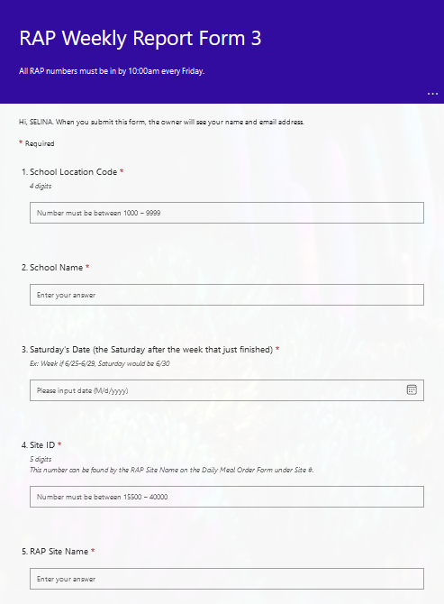
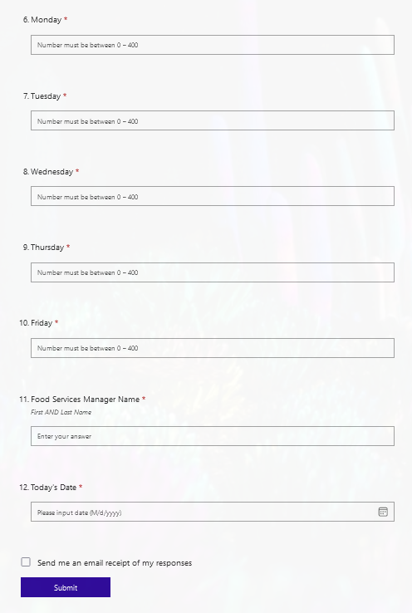
Weekly Report Form 3 Example
Notes:
TELL: The RAP Weekly Report Form 3 survey requires the specification of the Site Location Code and the Site ID#. The Site Location Code is the 4 digit Cafeteria Location Code. The Site ID # is the 5 digit Site ID# taken from the RAP Meal Order. The example on the red box above shows where one would locate the Site ID number on the Daily Food Order.

Slide 51
Participating RAP Programs
RAP Contacts
For information or clarification regarding the Summer RAP Program contact:
Dawn Soto
dawn.soto@lausd.net
Phone: 213-923-9603

Slide 52



RAP Trouble?
When to call Dawn:
  Meal daily order not posted by 7:30am
  No one at the park to receive meals
  Communicate if you are going to be late for delivery
  If park verbally requested meals
    Field trips
    Additional meals not on daily form
  Park refuses meals ordered
  Any menu item changes
Notes:
TELL: The RAP Weekly Report Form 3 survey requires the specification of the Site Location Code and the Site ID#. The Site Location Code is the 4 digit Cafeteria Location Code. The Site ID # is the 5 digit Site ID# taken from the RAP Meal Order. The example on the red box above shows where one would locate the Site ID number on the Daily Food Order.

